Slide 1

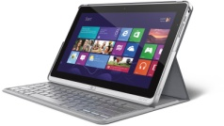


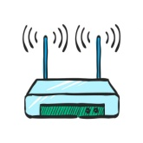


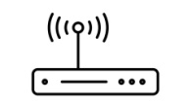

Sending Data From One Computer to Another
Mike
John
I.P. 192.168.1.4
I.P. 192.168.0.4
Hello!
Hello!
I.P. 192.168.1.3
I.P. 192.168.1.2
Backend Server
router
I.P. 192.168.1.2
router
firewall
firewall
firewall
Frontend Server
I.P. 12.12.123.15
I.P. 12.12.123.15
modem
I.P. 12.12.123.18
modem
firewall

